Slide 1


Object
Oriented
Programming
MEC Academy

Slide 2
Agenda
Operator += overloading
Friend function
Operator << overloading
Multiple inheritance
Protected access modifier
Practice
Dependencies
&
Issues / Risks
Schedule (High Level)
Completed Activities
Timeline
Action
Items
Change Requests

Slide 3
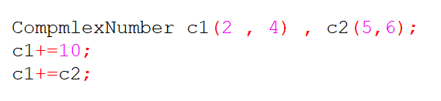
Operator += overloading
Example:
Overloading += operator in class complex number that has real and imaginary numbers.
We can overload it to add only to the real number , also we can overload it to add another complex number.

Slide 4
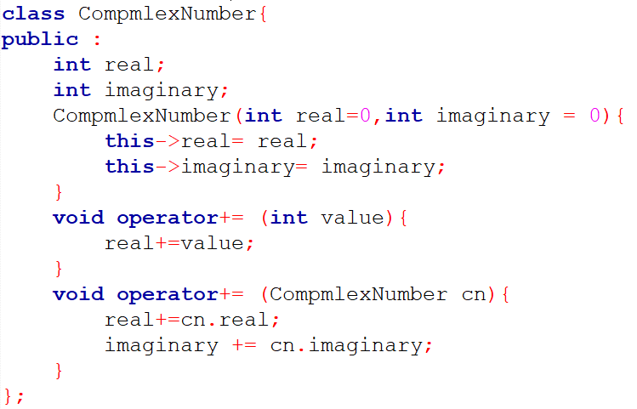
Example

Slide 5
Friend Function
It’s a function that is declared outside the class but it can access private and protected attributes.
It can’t be called from object like member function.
It should be declared in the class as a friend.
This line should be written in the class
The implementation of the function is outside the class.

Slide 6
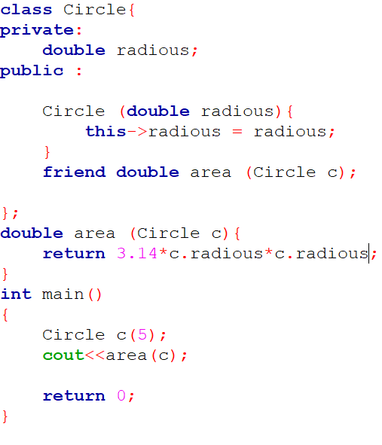
Example
Declaration inside the class
Implementation outside the class
Takes object of the class as parameter
Private attribute used outside the class easily

Slide 7
Friend Function cont.
Used when a function should access the private attributes of two classes so it is declared in these two classes as a friend function .

Slide 8
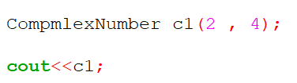
Operator << overloading
Used to print the data of the object by the cout.
Example :
Overloading the operator << in Complex number class .

Slide 9
Operator << overloading
It is a friend function.
Takes ostream as parameter.
Takes constant object as a parameter (because it will not change anything in the object ).preferred to be constant
It returns the ostream reference (to be able to print on the console in the same instruction cout<< cn <<endl; ) try the void

Slide 10
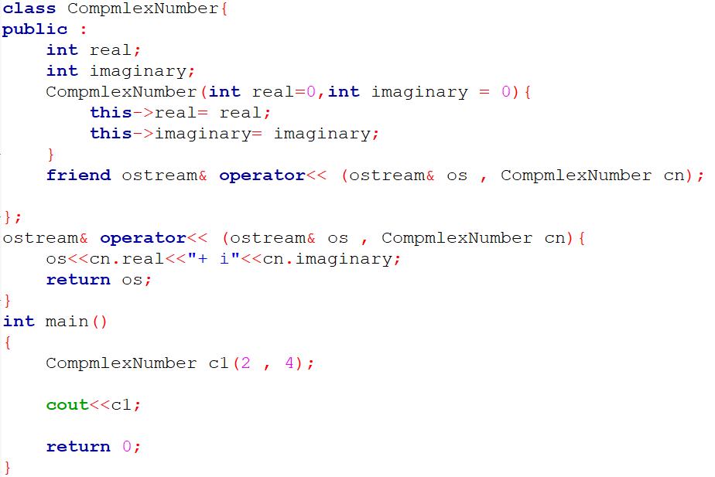
Example

Slide 11
Practice
Search on operator >> overloading
Implement it for class ComplexNumber

Slide 12
Multiple Inheritance
One class in c++ could inherit from more than one superclass.
The constructor of the child class will automatically call both constructors
The child could access all the attributes and methods from both super classes.

Slide 13
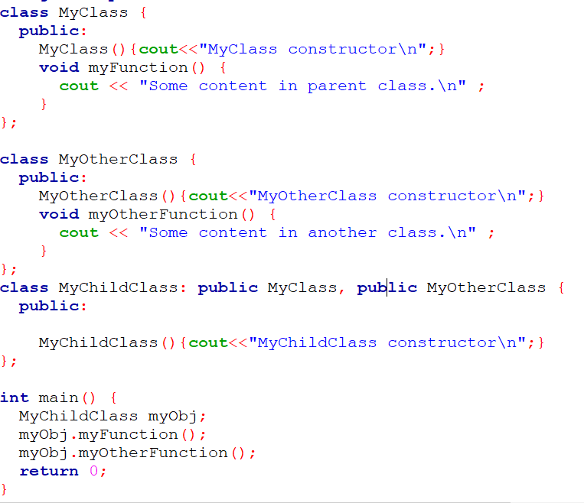
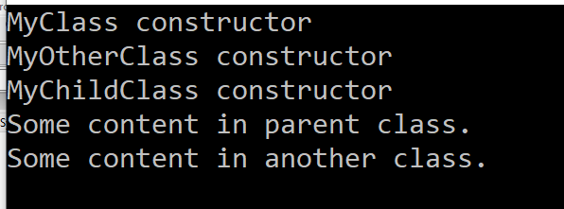

Example

Slide 14
Protected access modifier
Protected is the same as private (can’t be accessed outside the class unless the friend function).
The difference is protected can be accessed by the subclass (child).

Slide 15
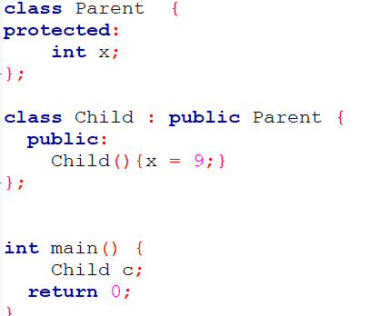
Example
This will not give an error

Slide 16
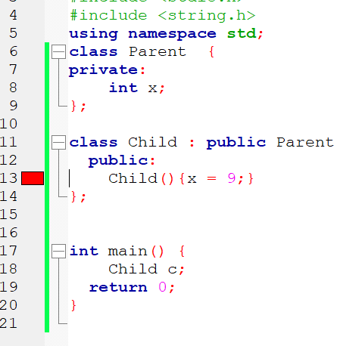
Example
This will give an error

